Slide 1
Sensor for Mobile Robots
many slides from Siegwart, Nourbaksh, and Scaramuzza, Chapter 4 and Jana Kosecka

Slide 2
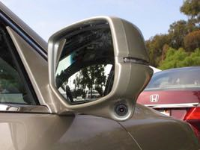
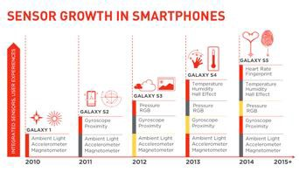
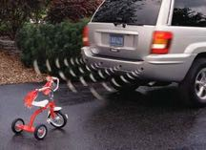
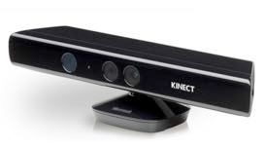


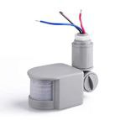
Sample of everyday sensors
+GPS
Camera
www.qualcomm.com
US
3D
Radar
PIR
Passive Infrared sensor
So far: Robotics always beneﬁts, never drives sensor development

Slide 3
Sensors for Mobile Robots
Why should a robotics engineer know about sensors?
Is the key technology for perceiving the environment
Understanding the physical principle enables appropriate use
Understanding the physical principle behind sensors enables us:
To properly select the sensors for a given application
To properly model the sensor system, e.g. resolution, bandwidth, uncertainties

Slide 4
Different sensors
differ in their precision and the kind of data that they provide, but none of them is able to completely solve the localization problem on its own.
E.g. encoder measures position, but used in this function only on robotic arms.
for nonholonomic robot: motions that return the encoder values to their initial position, do not necessarily drive the robot back to its starting point.
Different data: e.g.
accelerometer samples real-valued quantities that are digitized with some precision
odometer delivers discrete values that correspond to encoder increments.
vision sensor delivers an array of digitized real values (colors)

Slide 5
Classifying sensors
Type of information
Physical Principle
Absolute vs. derivative
Amount of information (Bandwidth)
Low and high reading (Dynamic range)
Accuracy and Precision

Slide 6
Functional Classification of Sensors
What:
Proprioceptive sensors (internal)
measure values internally to the system (robot),
e.g. motor speed, wheel load, heading of the robot, battery status
Exteroceptive sensors (external)
information from the robot’s environment
distances to objects, intensity of the ambient light, unique features.
How:
Passive sensors
Measure energy coming from the environment
Active sensors
emit their proper energy and measure the reaction
better performance, but some influence on environment

Slide 7
Important Questions
What are the sources of error?
What are we measuring?
vs.
What do we actually want to know?

Slide 8
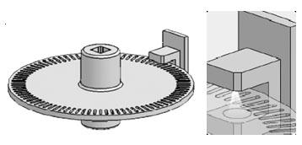
Robot Proprioception
Odometry/shaft encoders
Light/Magnetic/Radar
Simple
Widely Available
Limited Speed
Slippage

Slide 9

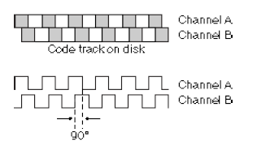
Wheel/Joint encoder Optical encoder
To sense angular speed and position
Quadrature encoder : pattern rotating with motor, and optical sensor
that registers black/white transitions
Can also be implemented magnetically or electrically (same principle). Main stream technology: CNC machines and RC servos.
Notes:
Encoders are used for sensing joint position and speed.
To obtain the direction of motion, quadrature encoders therefore have two sensors, A and B, that register an interleaving pattern with distance of a quarter phase. If A leads B, for example, the disk is rotating in a clockwise direction. If B leads A, then the disk is rotating in a counter-clockwise direction. It is also possible to create absolute encoders, an example of which is shown in the Figure on the right. The pattern is arranged in such a way that there is only one bit changing from one segment to the other.
This is known as “Gray code".

Slide 10
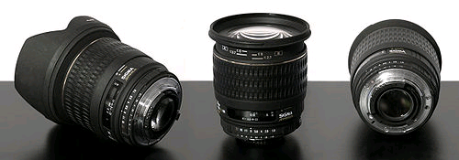
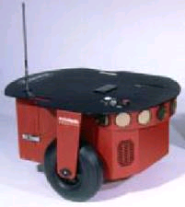
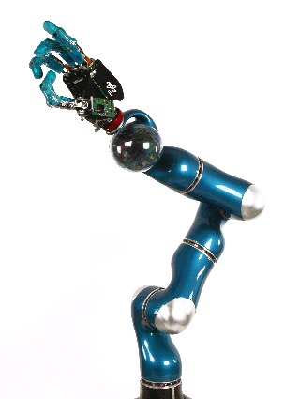
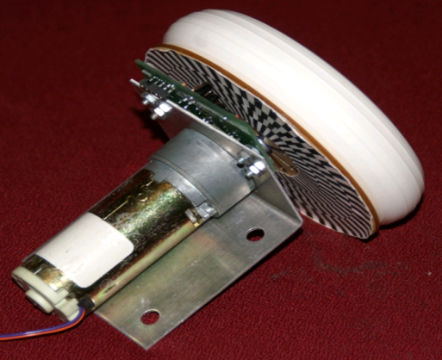
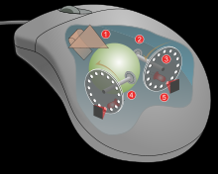
Wheel / Motor Encoders
measure position or speed of the wheels or steering
integrate wheel movements to get an estimate of the position -> odometry
optical encoders are proprioceptive sensors
typical resolutions: 64 - 2048 increments per revolution.
for high resolution: interpolation

Slide 11
Heading Sensors
Heading sensors can be proprioceptive (gyroscope, acceleration) or exteroceptive (compass, inclinometer).
Used to determine the robots orientation and inclination.
Allow, together with an appropriate velocity information, to integrate the movement to a position estimate.
This procedure is called deduced reckoning (ship navigation)

Slide 12



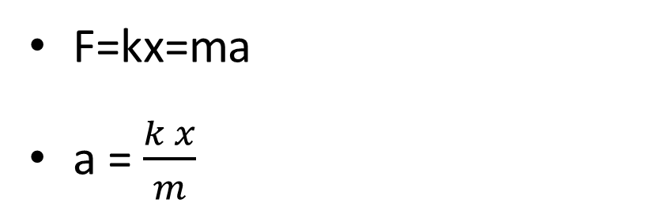
Accelerometer
F=kx=ma
a = $\frac{k x}{m}$
m
k
F
Accelerometers measure all external forces acting upon them, including gravity
accelerometer acts like a spring–mass–damper system

Slide 13
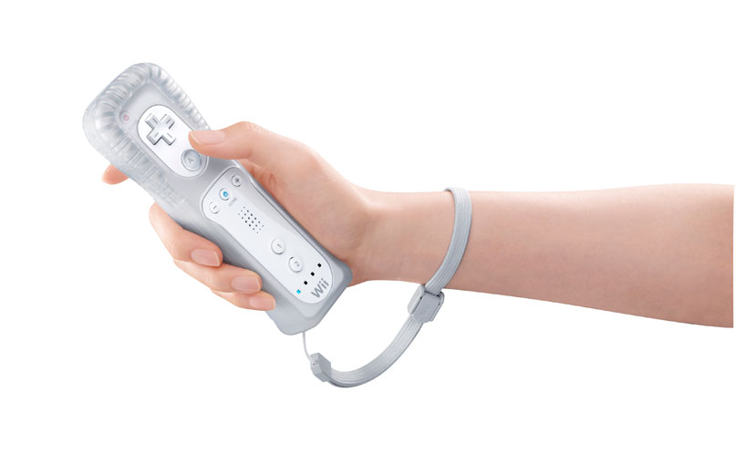
Accelerometers
Measure Linear Acceleration
Cheap
Limited DoF
Need to integrate for
speed and distance
Errors accumulate

Slide 14
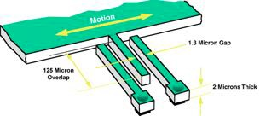
Modern accelerometers use Micro Electro-Mechanical Systems (MEMS) consisting of a spring-like structure with a proof mass. Damping results from the residual gas sealed in the device.
Omnidirectional accelerometer by 3 accelerometers in 3 orthogonal directions

Slide 15
Gyroscope
Heading sensors that preserve their orientation in relation to a fixed reference frame
absolute measure for the heading of a mobile system.
Two categories, the mechanical and the optical gyroscopes
Mechanical Gyroscopes
Standard gyro (angle)
Rate gyro (speed)
Optical Gyroscopes
Rate gyro (speed)

Slide 16
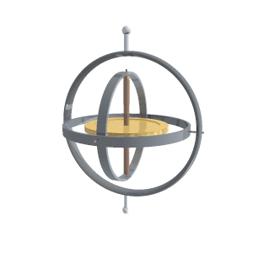
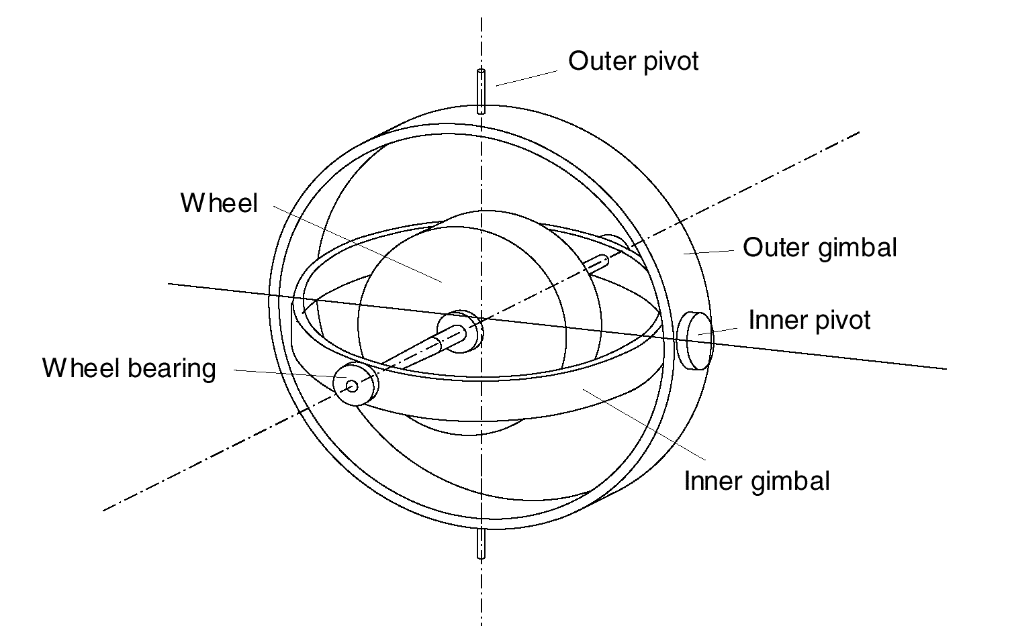
Mechanical Gyroscopes
Concept: inertial properties of a fast spinning rotor
Angular momentum associated with a spinning wheel keeps the axis of the gyroscope inertially stable.
and this allows to measure the orientation of the system relative to where the system was started.
however friction in the axes bearings will introduce torque and so drift
Quality: 0.1° in 6 hours (a high quality mech. gyro costs up to 100,000 $)

Slide 17
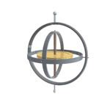
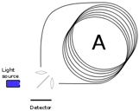
Gyroscopes
Measures orientation
Very expensive, infeasible to miniaturize
Rate gyroscopes measure rotational speed (variation)
Implemented using MEMS vibration devices, measure Coriolis force
Applications
– Correct heading

Slide 18
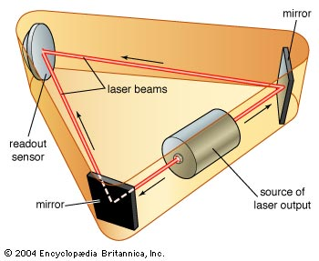
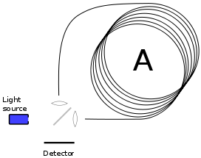
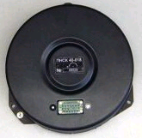
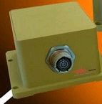
Optical Gyroscopes
First commercial use started only in the early 1980s when they were first installed in airplanes.
Optical gyroscopes
angular speed (heading) sensors using two monochromic light (or laser) beams from the same source.
One is traveling in a fiber clockwise, the other counterclockwise around a cylinder
Laser beam traveling in direction opposite to the rotation
slightly shorter path
phase shift of the two beams is proportional to the angular velocity Ω of the cylinder
In order to measure the phase shift, coil consists of as much as 5Km optical fiber
New solid-state optical gyroscopes based on the same principle are built using microfabrication technology.
Single axis optical gyro
3-axis optical gyro

Slide 19
Inertial measurement unit (IMU)
A device that uses gyroscopes and accelerometers to estimate the relative positions, and six degrees of velocities (translation and rotation)

Slide 20
Heading Sensors
Heading sensors can be proprioceptive (gyroscope, inclinometer) or exteroceptive (compass).
Used to determine the robots orientation and inclination.
Allow, together with an appropriate velocity information, to integrate the movement to an position estimate.
This procedure is called dead reckoning (ship navigation)

Slide 21
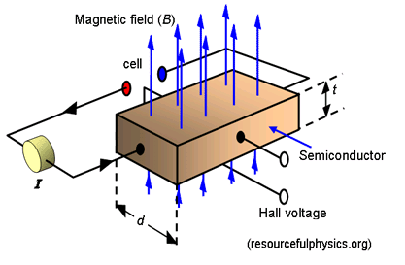
Compass
Since over 2000 B.C.
when Chinese suspended a piece of naturally magnetite from a silk thread and used it to guide a chariot over land.
Magnetic field on earth
absolute measure for orientation (even birds use it for migrations (2001 discovery))
Large variety of solutions to measure the earth magnetic field
mechanical magnetic compass
direct measure of the magnetic field (Hall-effect, magneto-resistive sensors)
Major drawback
weakness of the earth field (30 μTesla)
easily disturbed by magnetic objects or other sources
bandwidth limitations (0.5 Hz) and susceptible to vibrations
not feasible for indoor environments for absolute orientation
useful indoor (only locally)
Hall effect: semiconductor in in magnetic field. When current is applied to semiconductor across its length, there will be a voltage difference in the perpendicular direction, depending on the orientation of the magnetic field.

Slide 22
Global Positioning System (GPS) (1)
Developed for military use
In 1995 it became accessible for commercial applications
24 satellites (including three spares) orbiting the earth every 12 hours at a height of 20.190 km (since 2008: 32 satellites)
Four satellites are located in each of six planes inclined 55 degrees with respect to the plane of the earth’s equators
Location of any GPS receiver is determined through a time of flight measurement (satellites send orbital location (ephemeris) plus time; the receiver computes its location through trilateration and time correction)
Technical challenges:
Time synchronization between the individual satellites and the GPS receiver
Real time update of the exact location of the satellites
Precise measurement of the time of flight
Interferences with other signals

Slide 23
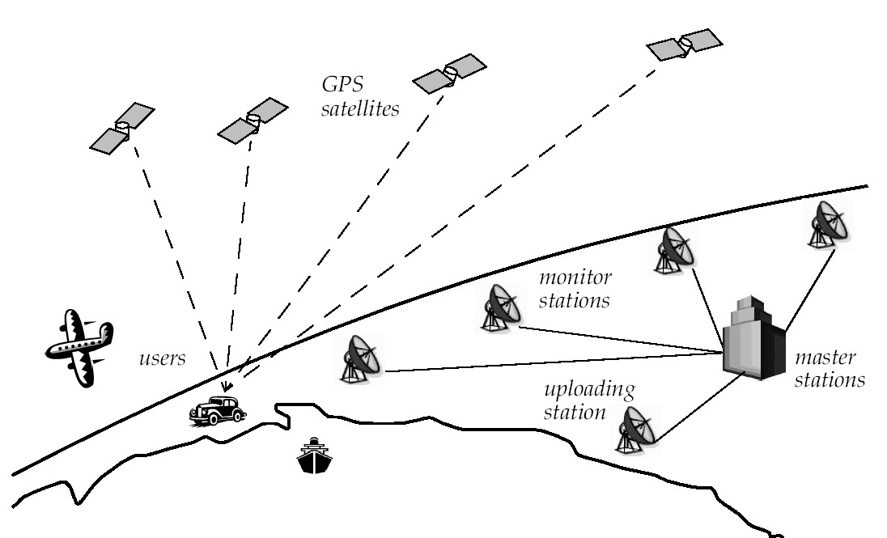
Global Positioning System (GPS) (2)

Slide 24
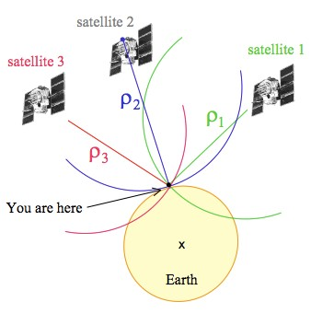
GPS positioning
Simple positioning principle
Satelites send signals, receivers received them with
delay
ρ = (t_{r} − t_{e} ) × speed of light
ρ = (X −X )² + (Y − Y )² + (Z − Z )²
s r s r s r
If we know at least three distance measurements, we can solve for position on earth.
In practice four are used, because the time difference between the GPS receiver's clock and the synchronized clocks of the satellites is unknown.

Slide 25
Higher accuracy GPS
DGPS (Differential GPS) uses a second static receiver at know exact position. This way errors can be correct and resolution improved (~1m accuracy)
Take into account phase of carrier signal. There are two carriers at 19cm and 24 cm. (1cm accuracy) (both DGPS + phase less than 1cm)

Slide 26
General principle: beacon based sensors :
indoor-GPS solutions, either active or passive beacons that are mounted in the environment at known locations.
Passive beacons: infrared reflecting stickers arranged in a certain pattern; 2D barcodes detected using cameras.
Active beacons usually emit radio, ultrasound or a combination thereof, to estimate the robot's range to these beacons.

Slide 27
(Active) Range Sensing strategies
Active range sensors
Ultrasound
Laser range sensor
Slides adopted from Siegwart and Nourbakhsh

Slide 28
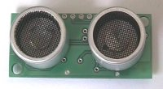
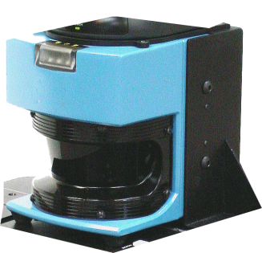
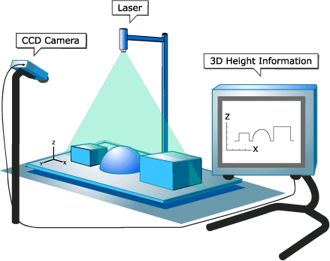
Range sensors
Time of flight active range sensing
Sonar
Laser range finder
Time of Flight Camera
Geometric active range sensor
Structured light

Slide 29
Range Sensors (time of flight) (1)
Range distance measurement: called range sensors
Range information:
key element for localization and environment modeling
Ultrasonic sensors as well as laser range sensors make use of propagation speed of sound or electromagnetic waves respectively. The traveled distance of a sound or electromagnetic wave is given by
d = c . t
■
Where
d = distance traveled (usually round-trip)
c = speed of wave propagation
t = time of flight.
4.1.6

Slide 30
Range Sensors (time of flight) (2)
It is important to point out
Propagation speed v of sound: 0.3 m/ms
Propagation speed v of electromagnetic signals: 0.3 m/ns,
one million times faster.
3 meters
is 10 ms ultrasonic system
only 10 ns for a laser range sensor
laser range sensors expensive and delicate
The quality of time of flight range sensors manly depends on:
Uncertainties about the exact time of arrival of the reflected signal
Inaccuracies in the time of fight measure (laser range sensors)
Opening angle of transmitted beam (ultrasonic range sensors)
Interaction with the target (surface, specular reflections)
Variation of propagation speed
Speed of mobile robot and target (if not at stand still)
4.1.6

Slide 31
Factsheet: Ultrasonic Range Sensor
emitter
1. Operational Principle An ultrasonic pulse is generated by a piezo-electric emitter, reflected by an object in its path, and sensed by a piezo-electric receiver. Based on the speed of sound in air and the elapsed time from emission to reception, the distance between the sensor and the object is easily calculated.
2. Main Characteristics Precision influenced by angle to object (as illustrated on the next slide) Useful in ranges from several cm to several meters Typically relatively inexpensive
3. Applications Distance measurement (also for transparent surfaces) Collision detection
receiver
<http://www.robot-electronics.co.uk/
shop/Ultrasonic_Rangers1999.htm>

Slide 32
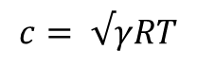
Ultrasonic Sensor (sound) (1)
transmit a packet of (ultrasonic) pressure waves
distance d of the echoing object can be calculated based on the propagation speed of sound c and the time of flight t.
c.t
d =
2
The speed of sound c (340 m/s) in air is given by
where
$$c= √γRT$$
γ
:ratio of specific heats
R: gas constant
T: temperature in degree Kelvin

Slide 33



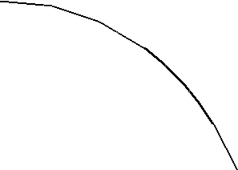
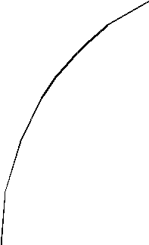
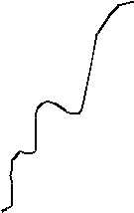
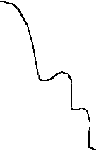
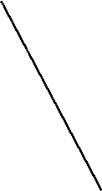

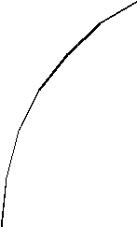
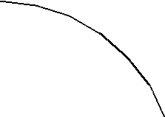
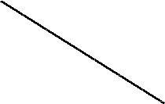
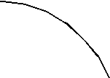

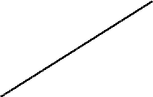
Ultrasonic Sensor (sound) (2)
typically a frequency: 40 - 180 kHz
generation of sound wave: piezo transducer
transmitter and receiver separated or not separated
sound beam propagates in a cone like manner
opening angles around 20 to 40 degrees
regions of constant depth
segments of an arc (sphere for 3D)
Effective range 12cm, 5m
Accuracy between 98-99%
In mobile applications: accuracy ~2cm
0°
measurement cone
30°
60°
Amplitude [dB]
Typical intensity distribution of a ultrasonic sensor

Slide 34
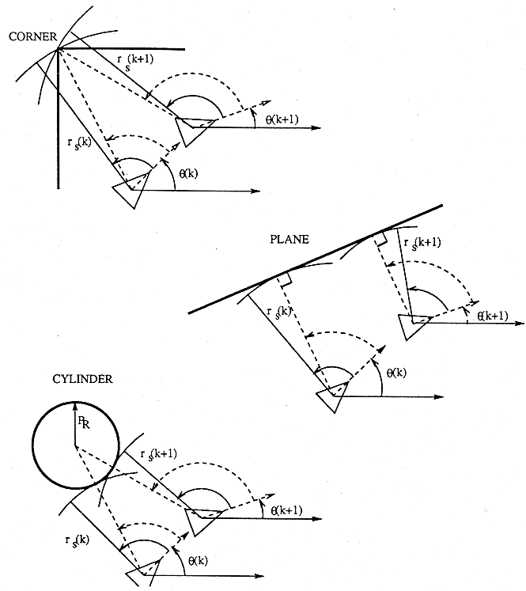
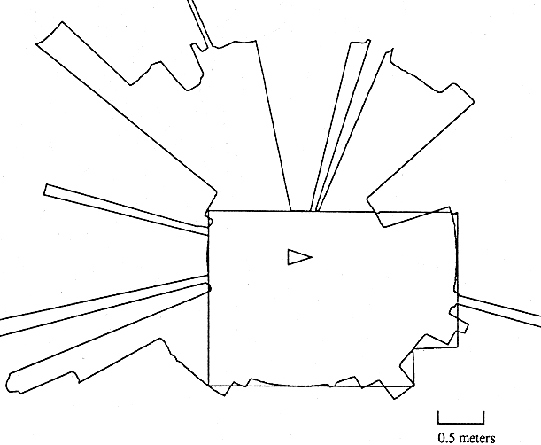
Ultrasonic Sensor (sound) (3)
Other problems for ultrasonic
sensors
soft surfaces that absorb most of the sound energy
surfaces that are far from being perpendicular to the direction of the sound -> specular reflection
a) 360° scan
b) results from different geometric primitives

Slide 35
Sources of Error
Opening angle
Crosstalk
Specular reflection

Slide 36
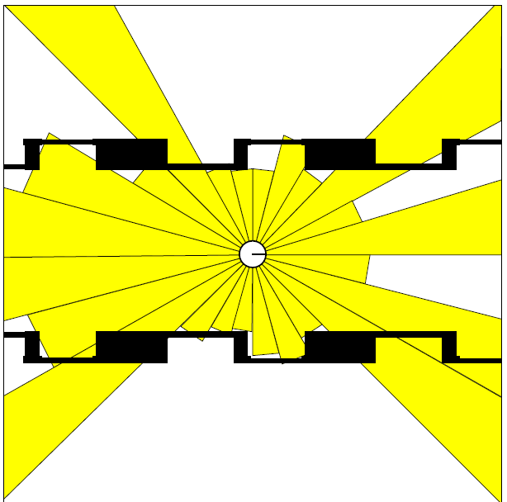
Typical Ultrasound Scan
Slide adopted from C. Stachniss

Slide 37
Parallel Operation
Given a 15 degrees opening angle, 24 sensors are needed to cover the whole 360 degrees area around the robot.
Let the maximum range we are interested in be 10m.
The time of flight then is 2*10/330 s=0.06 s
A complete scan requires 1.45 s
To allow frequent updates (necessary for high speed) the sensors have to be fired in parallel.
This increases the risk of crosstalk
Because they send out cones they are able to detect small obstacles without
a ray having to hit them directly . Sensor of choice in automated parking helpers
in cars.

Slide 38
Laser Range Sensor (time of flight, electromagnetic) (1)
Time of flight measurement
Pulsed laser (today the standard)
measurement of elapsed time directly
resolving picoseconds
Phase shift measurement to produce range estimation
technically easier than the above method

Slide 39

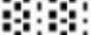
Laser Range Sensor (electromagnetic) (2)
D
Transmitter
P
L
Target
Phase
Transmitted Beam Reflected Beam
Measurement
Laser light instead of sound
Transmitted and received beams coaxial
Transmitter illuminates a target with a collimated beam
Receiver detects the time needed for round-trip
Lidar (light detection and ranging)
4.1.6

Slide 40
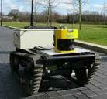
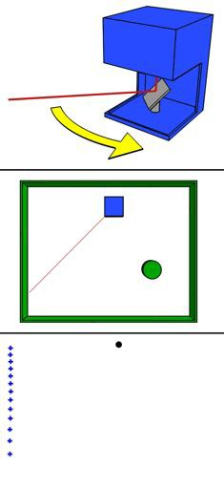
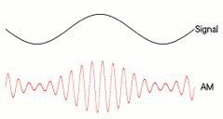
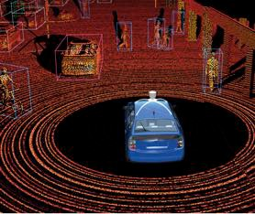
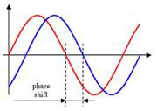
Distance from phase shift
5 Mhz ~ 60m
https://en.wikipedia.org/wiki/Lidar

Slide 41
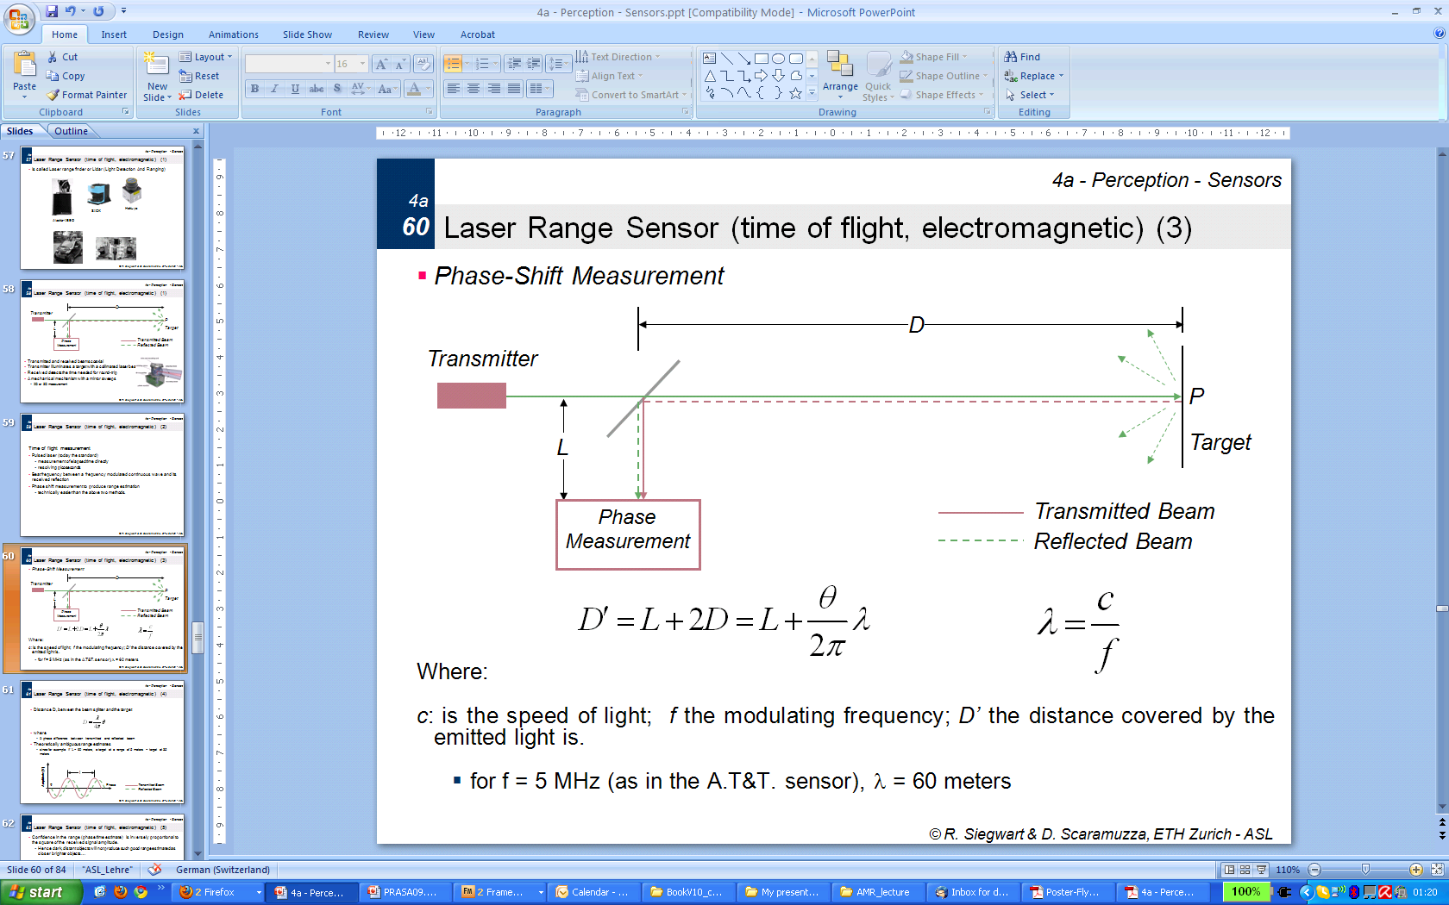
Laser Range Sensor (time of flight, electromagnetic) (3)
D
Phase-Shift Measurement
Where:
c: is the speed of light; f the modulating frequency; D’ the distance covered by the emitted light is.
for f = 5 MHz (as in the A.T&T. sensor), λ = 60 meters
Transmitter
P
L
Target
Phase Measurement
Transmitted Beam
Reflected Beam

Slide 42

Laser Range Sensor (time of flight, electromagnetic) (4)
Distance D, between the beam splitter and the target
where
θ: phase difference between transmitted and reflected beam
Theoretically ambiguous range estimates
since for example if λ = 60 meters, a target at a range of 5 meters = target at 35 meters
l
Amplitude [V]
q
Phase
Transmitted Beam
Reflected Beam

Slide 43


4.1.6
Laser Range Sensor (electromagnetic) (5)
Confidence in the range (phase estimate) is inversely proportional to the square of the received signal amplitude.
Hence dark, distant objects will not produce such good range estimated as closer brighter objects …

Slide 44

Laser Range Sensor (electromagnetic)
Typical range image of a 2D laser range sensor with a rotating mirror. The length of the lines through the measurement points indicate the uncertainties.
4.1.6

Slide 45


Laser Range Finder: Applications
Autonomous Smart:
ASL ETH Zurich
Stanley: Stanford
(winner of the 2005 Darpa Grand Challenge)
5 Sick laser scanners

Slide 46






Robots Equipped with Laser Scanners
29

Slide 47






Typical Scans
30

Slide 48



Performance of a laser scanner
Range: diﬀerence between highest and lowest reading
Dynamic range: ratio of lowest and highest reading
Resolution: minimum diﬀerence between
values
Linearity: variation of output as function of input
Bandwidth: speed with which measurements are delivered
Cross-Sensitivity: sensitivity to environment
Accuracy: diﬀerence between measured and true value
Precision: reproducibility of results
Hokuyo URG

Slide 49

3D Laser

Slide 50

3D Laser

Slide 51






3D Range Sensor: Time Of Flight (TOF) camera
A Time-of-Flight camera (TOF camera, figure ) works similarly to a lidar with the advantage that the whole 3D scene is captured at the same time and that there are no moving parts. This device uses a modulated infrared lighting source to determine the distance for each pixel of a Photonic Mixer Device (PMD) sensor.
Swiss Ranger 3000
(produced by MESA)
ZCAM
(from 3DV Systems now bought by
Microsoft for Project Natal)

Slide 52

Kinect 2
Illustration of the indirect time-of-flight method.
Kinect 2.0 sensor takes a pixel and divides it in half. Half of this pixel is then turned on and off really fast such that, when it is on, it is absorbing photons of laser light, and when it is off, it rejects the photons. The other half of the pixel is doing the same thing; however, its doing it 180 degrees out of phase from the first half . At the same, a laser light source is also being pulsed in phase with the first pixel half such that, if the first half is on, so is the laser. And if the pixel half is off, the laser will be too.
http://www.gamasutra.com/blogs/DanielLau/20131127/205820/The_Science_Behind_Kinects_or_Kinect_10_versus_20.php

Slide 53



Distance from structured light
Zhang et al. (2002)
hIp://www.depthbiomechanics.co.uk/?p=100

Slide 54


Structured Light (vision, 2 or 3D): Structured Light
b
a
b
u
Eliminate the correspondence problem by projecting structured light on the scene.
Slits of light or emit collimated light (possibly laser) by means of a rotating mirror.
Light perceived by camera
Range to an illuminated point can then be determined from simple geometry.

Slide 55
Structured Light (vision, 2 or 3D)
Baseline length b:
the smaller b is the more compact the sensor can be.
the larger b is the better the range resolution is.
Note: for large b, the chance that an illuminated point is not visible to the receiver increases.
Focal length f:
larger focal length f can provide
either a larger field of view
or an improved range resolution
however, large focal length means a larger sensor head
D
Laser / Collimated beam
P
L
Target
x
Transmitted Beam
Lens
Reflected Beam
f
Position-Sensitive Device (PSD)
or Linear Camera

Slide 56

Microsoft Kinect

Slide 57

Kinect

Slide 58

Kinect 1
Kinect uses a speckle pattern of dots that are projected onto a scene by means of an IR projector, and detected by an IR camera.
Each IR dot in the speckle pattern has a unique surrounding area and therefore allows each dot to be easily identified when projected onto a scene. The processing performed in the Kinect in order to calculate depth is essentially a stereo vision computation.

Slide 59

Kinect 1
IR speckles are of three different sizes that are optimised for use in different depth ranges, meaning . The Kinect can operate between approximately 1m and 8m.
In addition to pure pixel shift the Kinect also compares the observed size of a particular dot with the original size in the reference pattern. Changes in size or shape are also factored into the depth calculations. These calculations are all performed on the device in real time as part of a system on chip (SOC) and results in a depth image of 640×480 pixels and a frame rate of 30fps.

Slide 60
Characterizing Sensor Performance
4.1.2
Basic sensor response ratings (cont.)
Resolution
minimum difference between two values
usually: lower limit of dynamic range = resolution
for digital sensors it is usually the A/D resolution.
e.g. 5V / 255 (8 bit)
Linearity
variation of output signal as function of the input signal
linearity is less important when signal is after treated with a computer
Bandwidth or Frequency
the speed with which a sensor can provide a stream of readings
usually there is an upper limit depending on the sensor and the sampling rate
Lower limit is also possible, e.g. acceleration sensor

Slide 61


In Situ Sensor Performance (1)
Characteristics that are relevant for real world environments
Sensitivity
ratio of output change to input change
however, in real world environment, the sensor has very often high sensitivity to other environmental changes, e.g. illumination
Cross-sensitivity
sensitivity to environmental parameters that are orthogonal to the target parameters
Error / Accuracy
difference between the sensor’s output and the true value
error
m = measured v = true value
4.1.2

Slide 62

In Situ Sensor Performance (2)
Characteristics that are especially relevant for real world environments
Systematic error -> deterministic errors
caused by factors that can (in theory) be modeled -> prediction
e.g. calibration of a laser sensor or of the distortion cause by the optic of a camera
Random error -> non-deterministic
no prediction possible
however, they can be described probabilistically
e.g. Hue instability of camera, black level noise of camera ..
Precision
reproducibility of sensor results
4.1.2

Slide 63
Characterizing Error: The Challenges in Mobile Robotics
Mobile Robot has to perceive, analyze and interpret the state of the surrounding
Measurements in real world environment are dynamically changing and error prone.
Examples:
changing illuminations
specular reflections
light or sound absorbing surfaces
cross-sensitivity of robot sensor to robot pose and robot- environment dynamics
rarely possible to model -> appear as random errors
systematic errors and random errors might be well defined in controlled environment. This is not the case for mobile robots !!
4.1.2

Slide 64
Multi-Modal Error Distributions: The Challenges in …
Behavior of sensors modeled by probability distribution (random errors)
usually very little knowledge about the causes of random errors
often probability distribution is assumed to be symmetric or even Gaussian
however, it is important to realize how wrong this can be!
Examples:
Sonar (ultrasonic) sensor might overestimate the distance in real environment and is therefore not symmetric
Thus the sonar sensor might be best modeled by two modes:
mode for the case that the signal returns directly
mode for the case that the signals returns after multi- path reflections.
Stereo vision system might correlate to images incorrectly, thus
causing results that make no sense at all
4.1.2

